Slide 1
TENSE Ball:
Triboelectric Nanogenerator-based Therapeutic Stress Ball
Professor: Dr. Omer Inan
ECE 4781/ 6781
12/3/2020
Group Members:
Can F. Usanmaz, Fereshteh Shahmiri, Steven A. Schwartz,
Alec Mills, Alexander A. Fache, Omari Weems

Slide 2
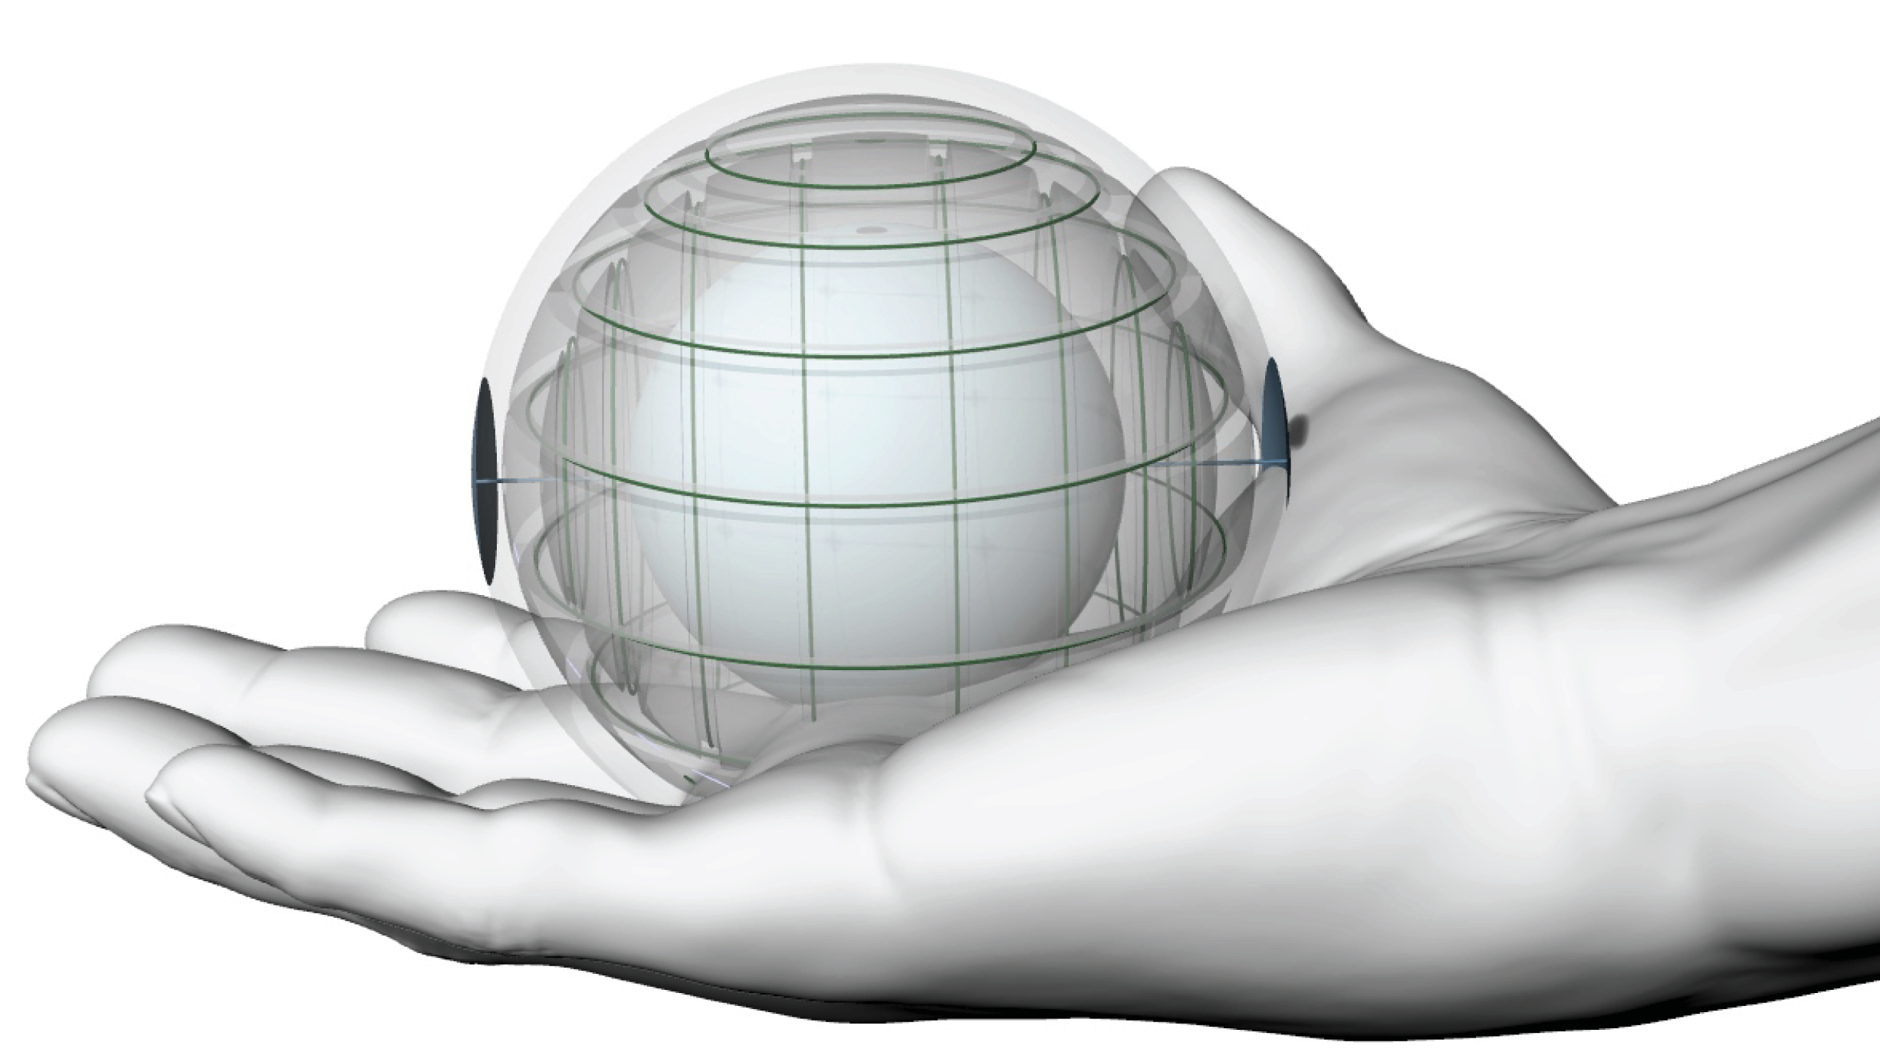
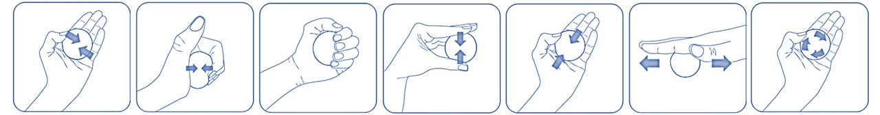
INTRODUCTION
Common restorative hand therapy exercises that promote strength and dexterity

Slide 3
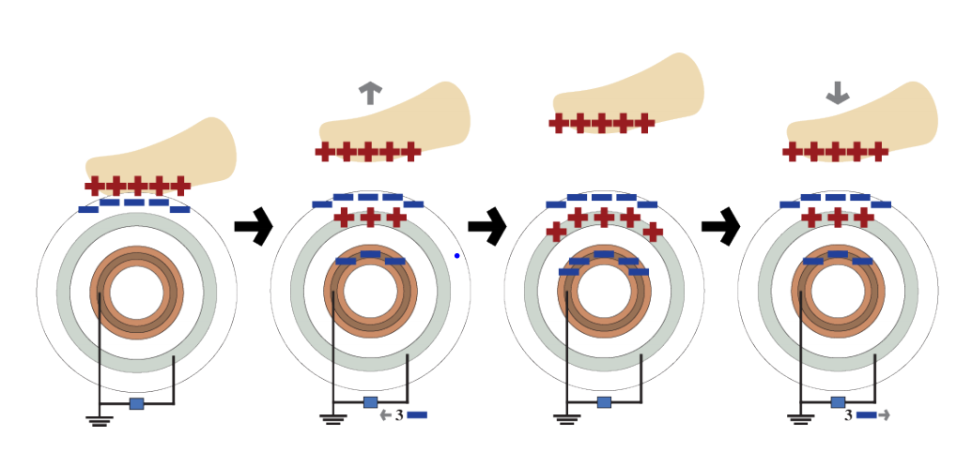
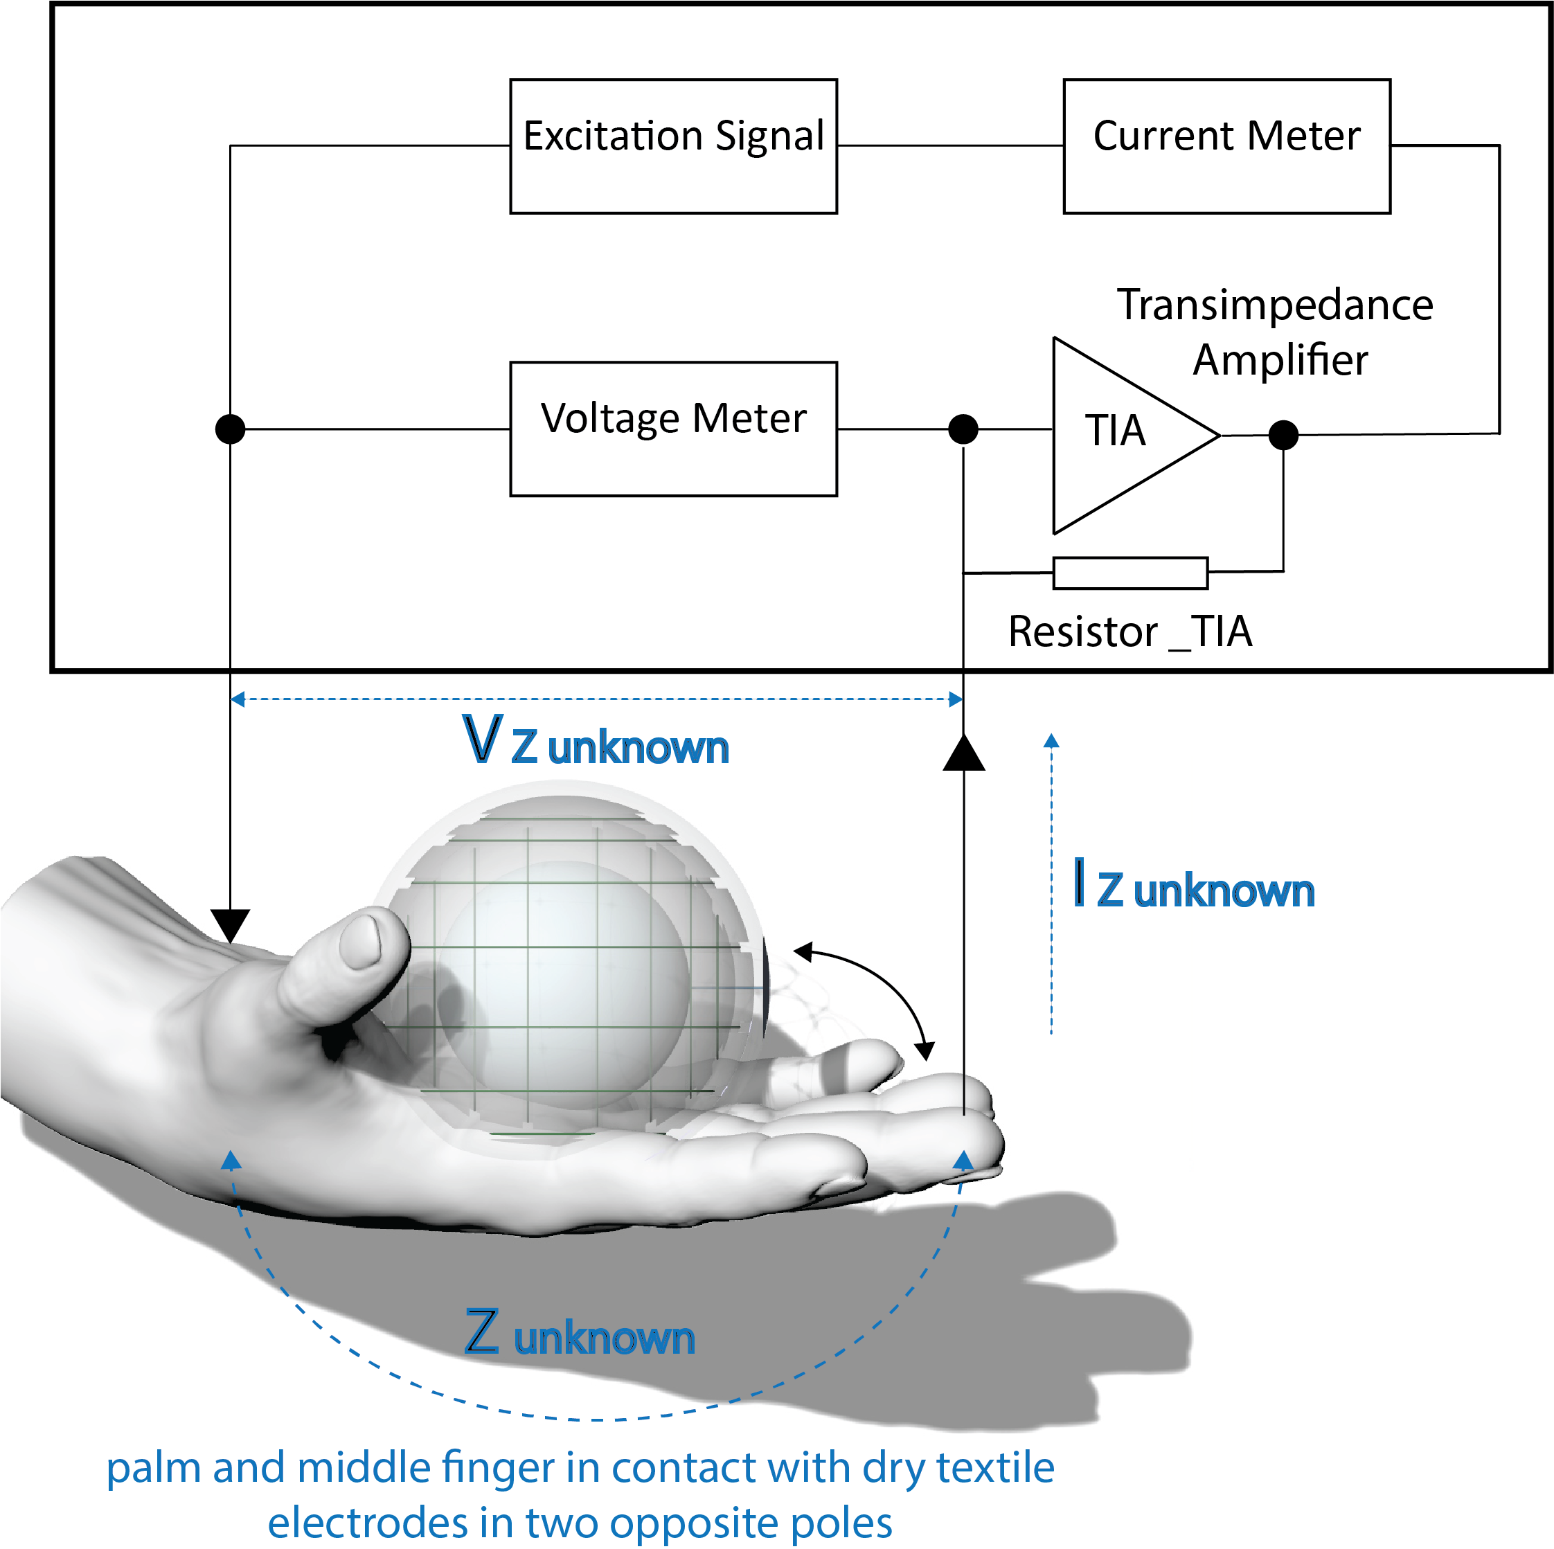
OPERATION
Electrodermal Activity Measurement
Triboelectric Nanogenerator Principles
Monitoring TENSE ball deformations based on charge distribution between Device Layers which is induced from skin
Accelerometer (3-Axis)

Slide 4
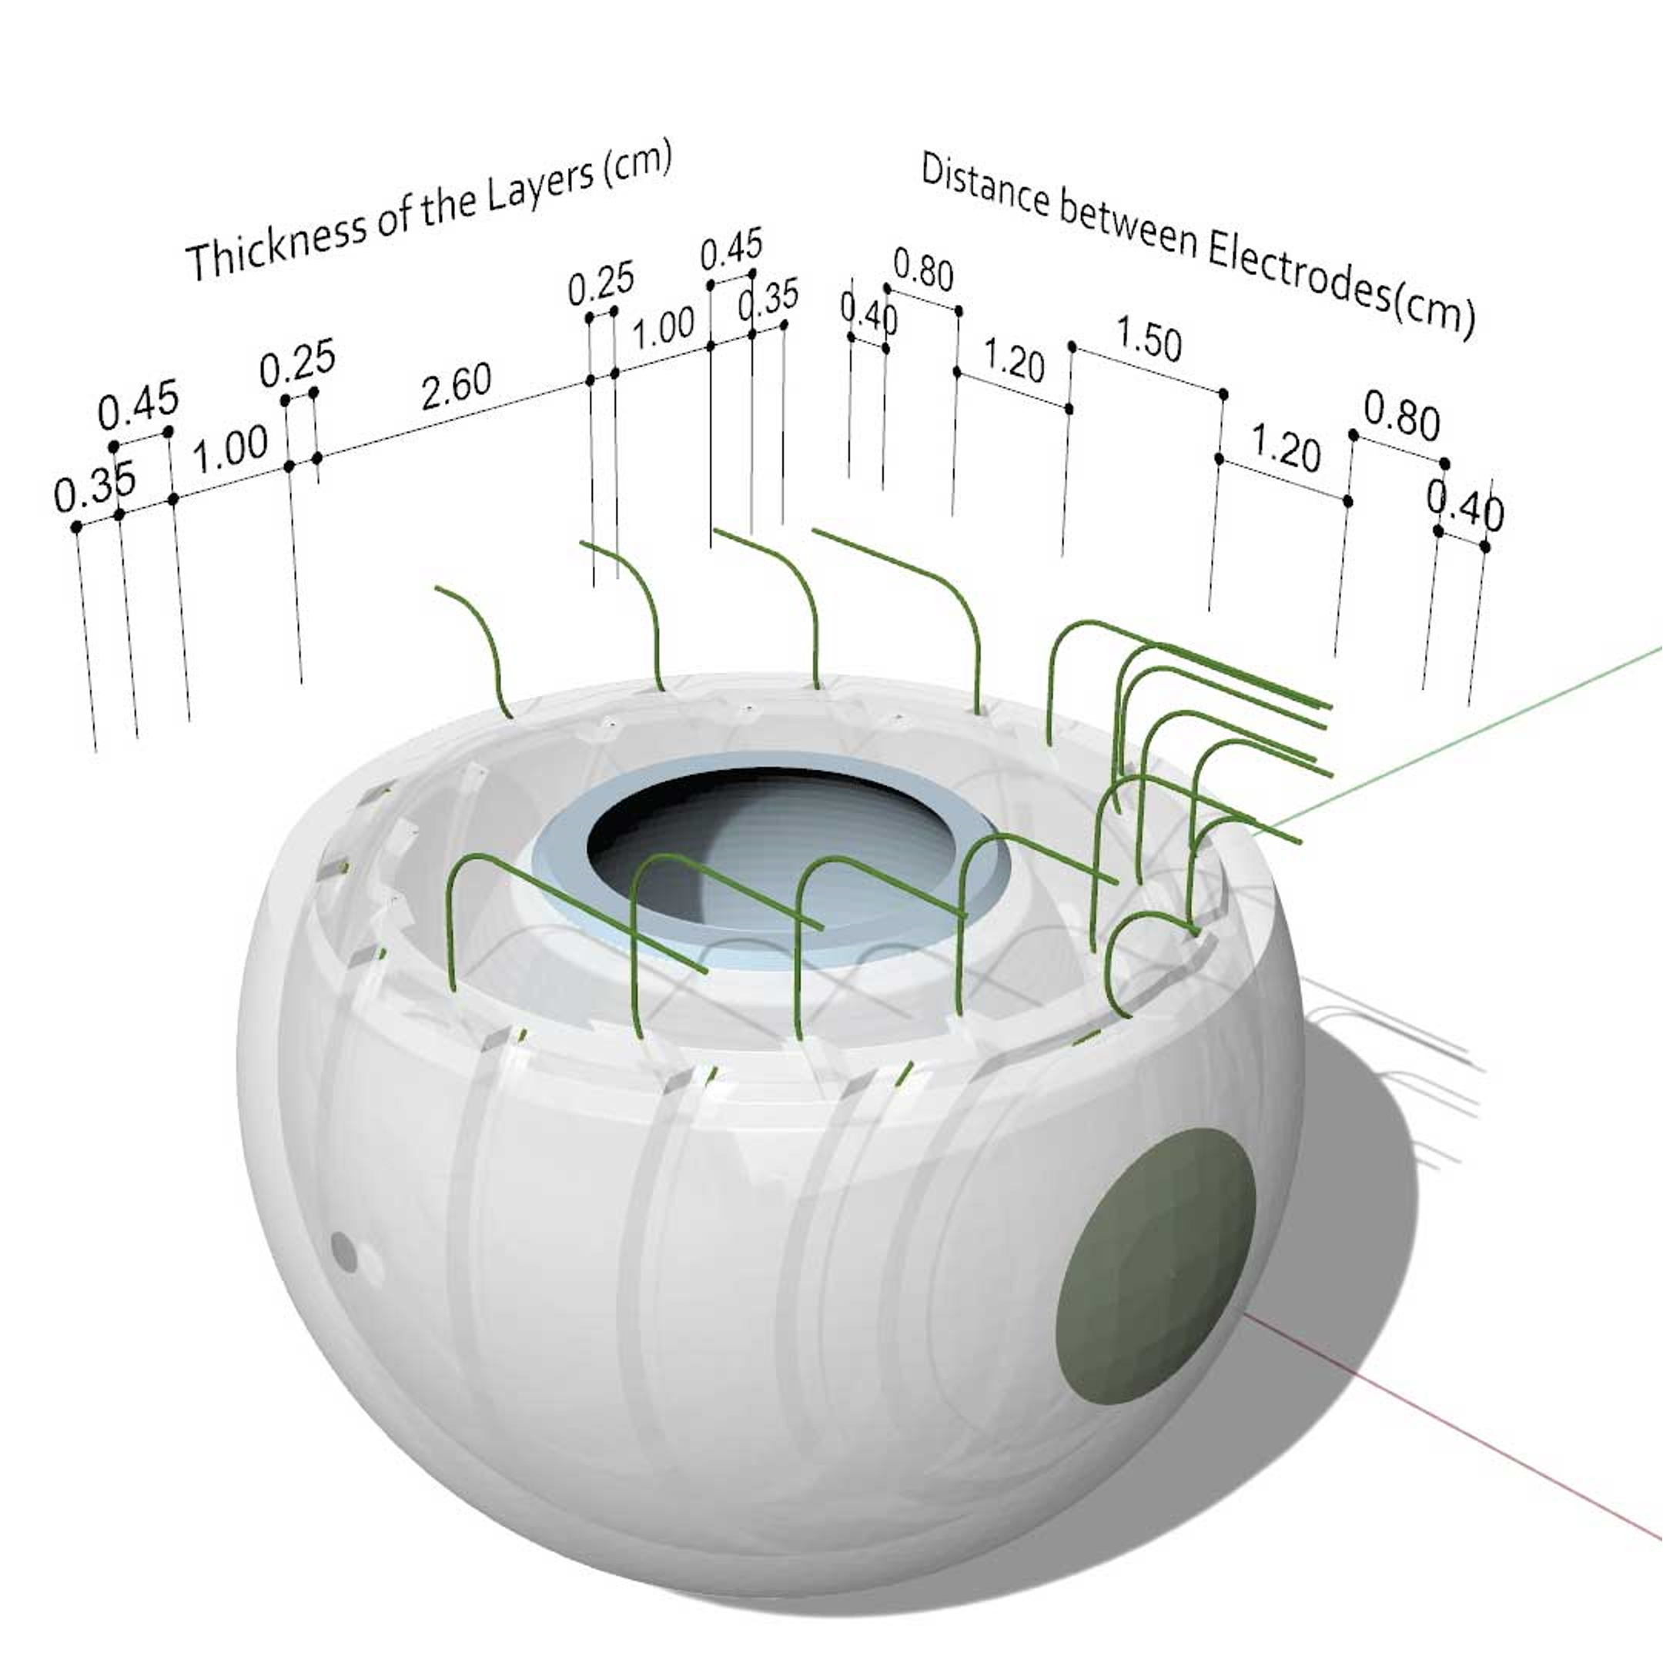
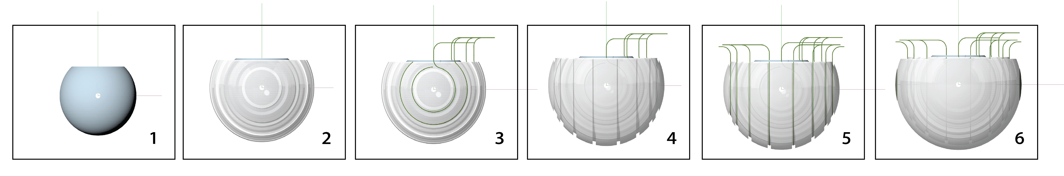
FABRICATION
Fabrication Process –
1)3D printed core, 2, 4,6) first silicone layer, 3, 5) first layer of Nylon thread, 6) textile dry electrodes for EDA measurement

Slide 5
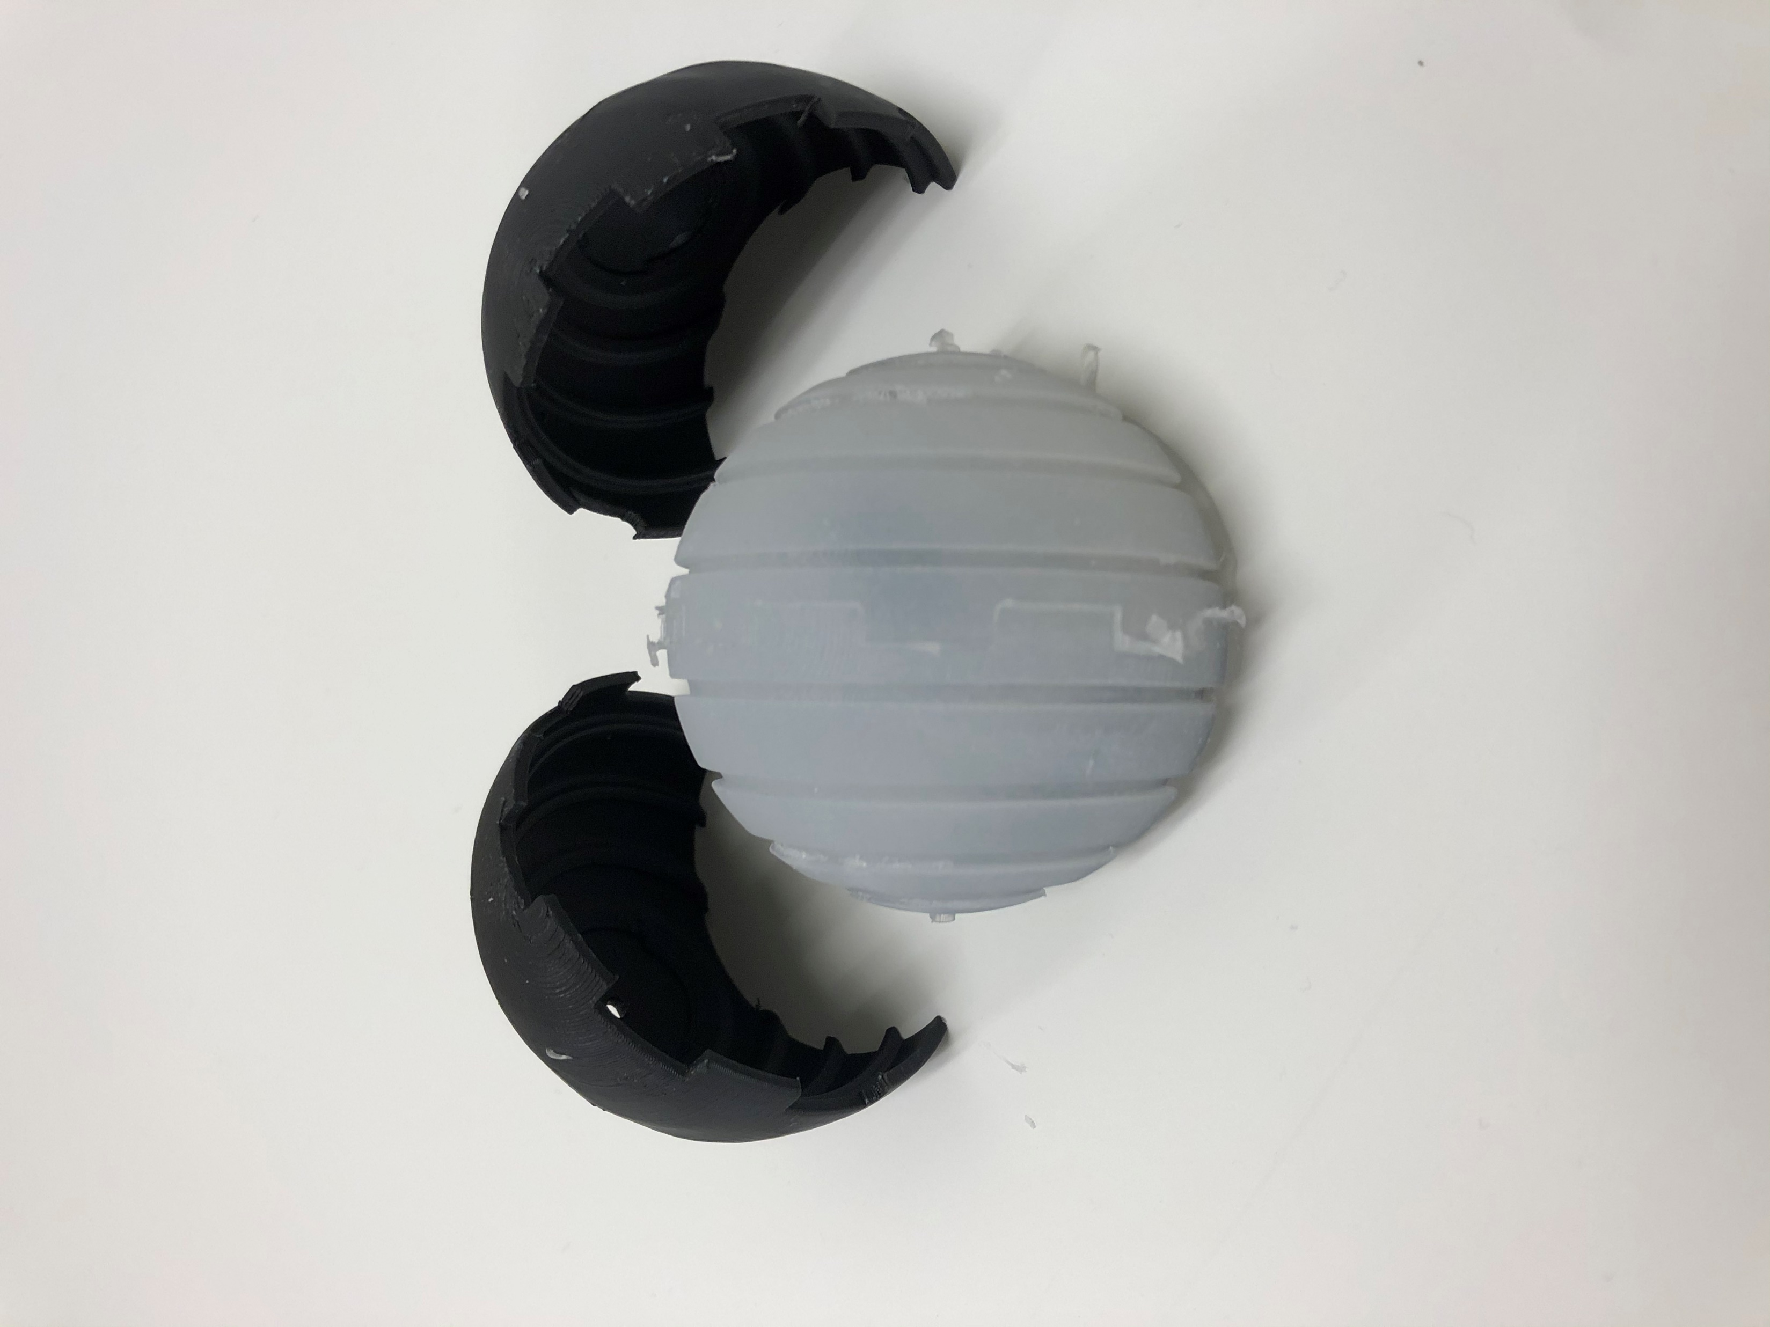
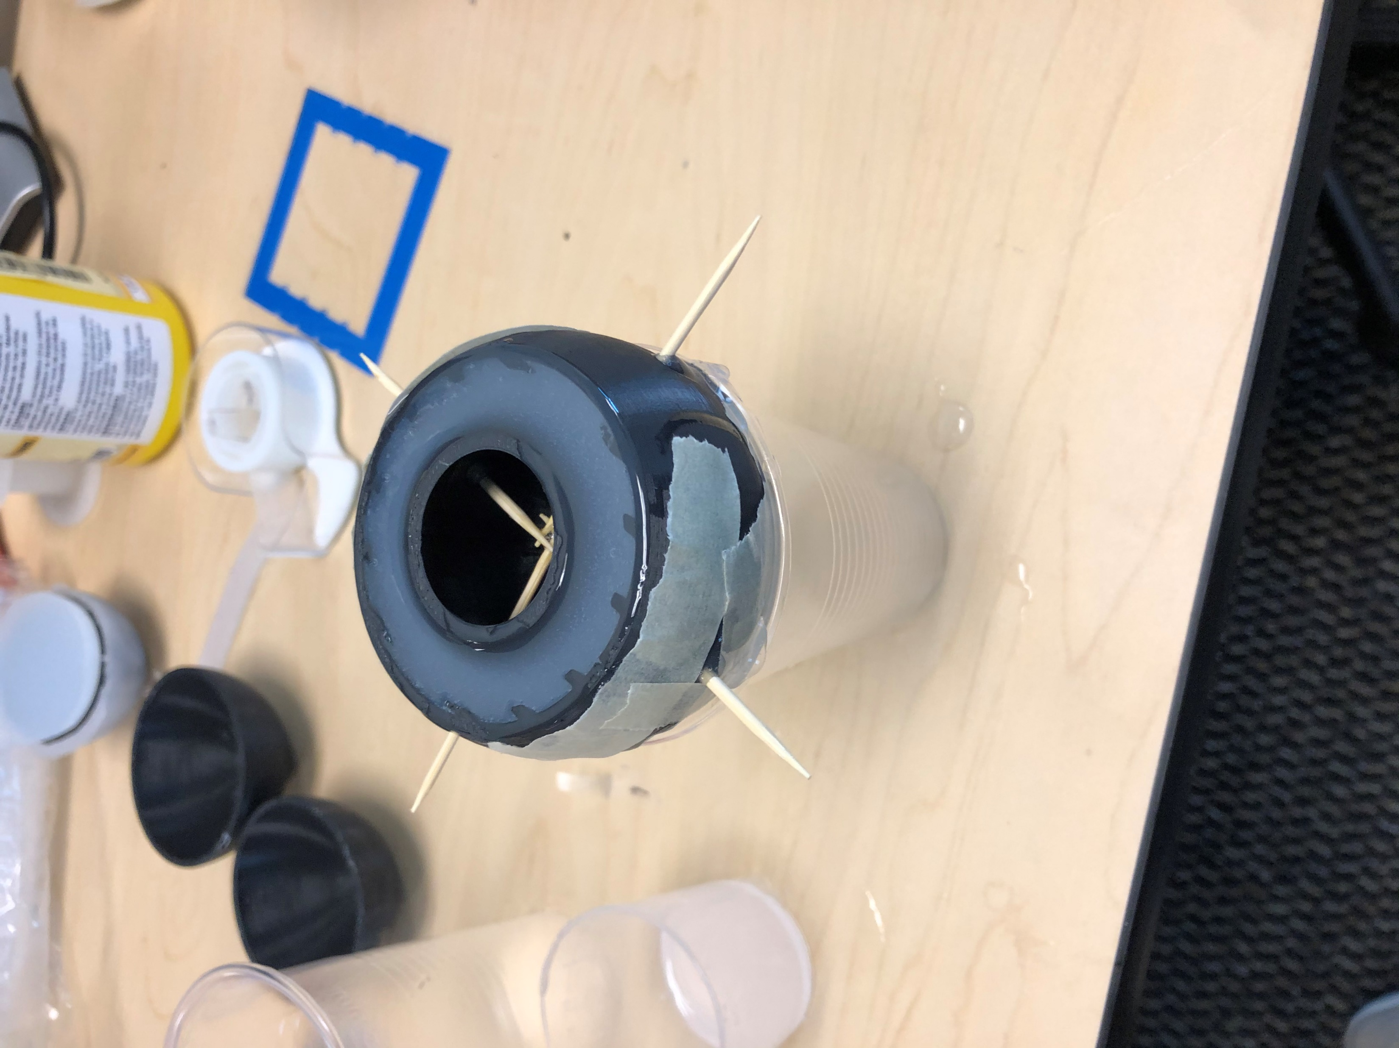
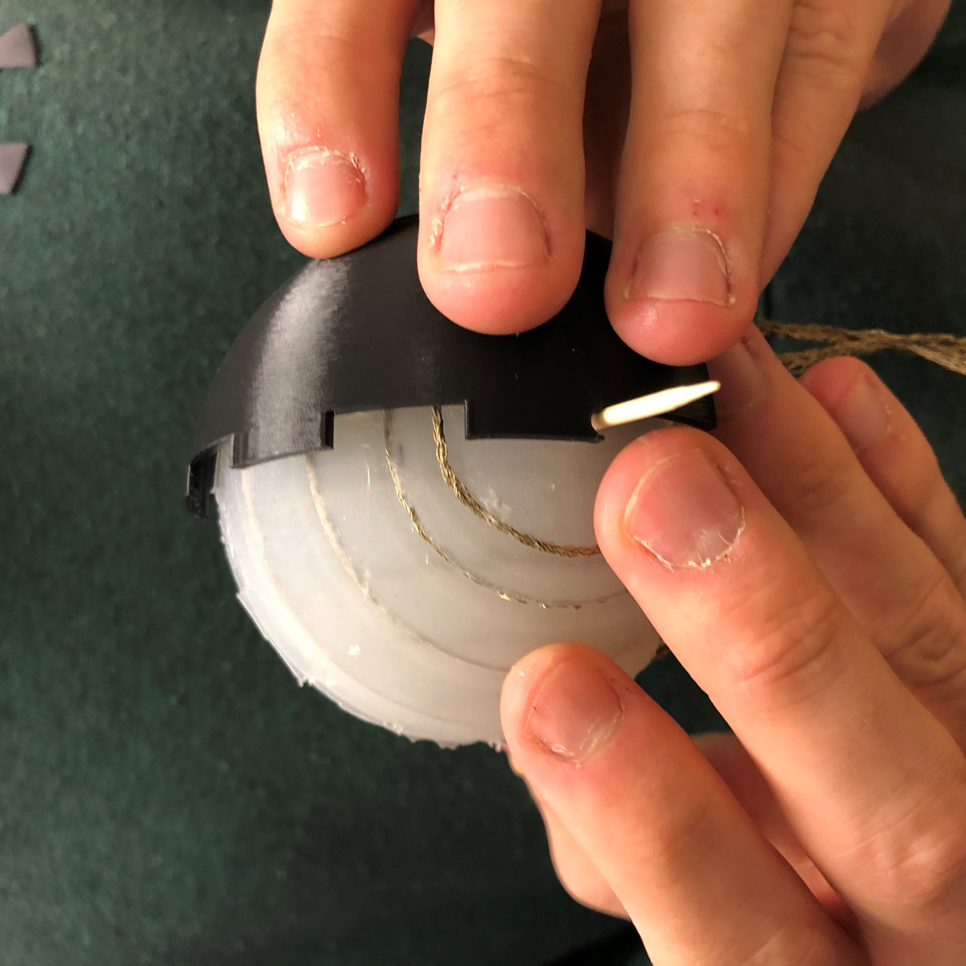
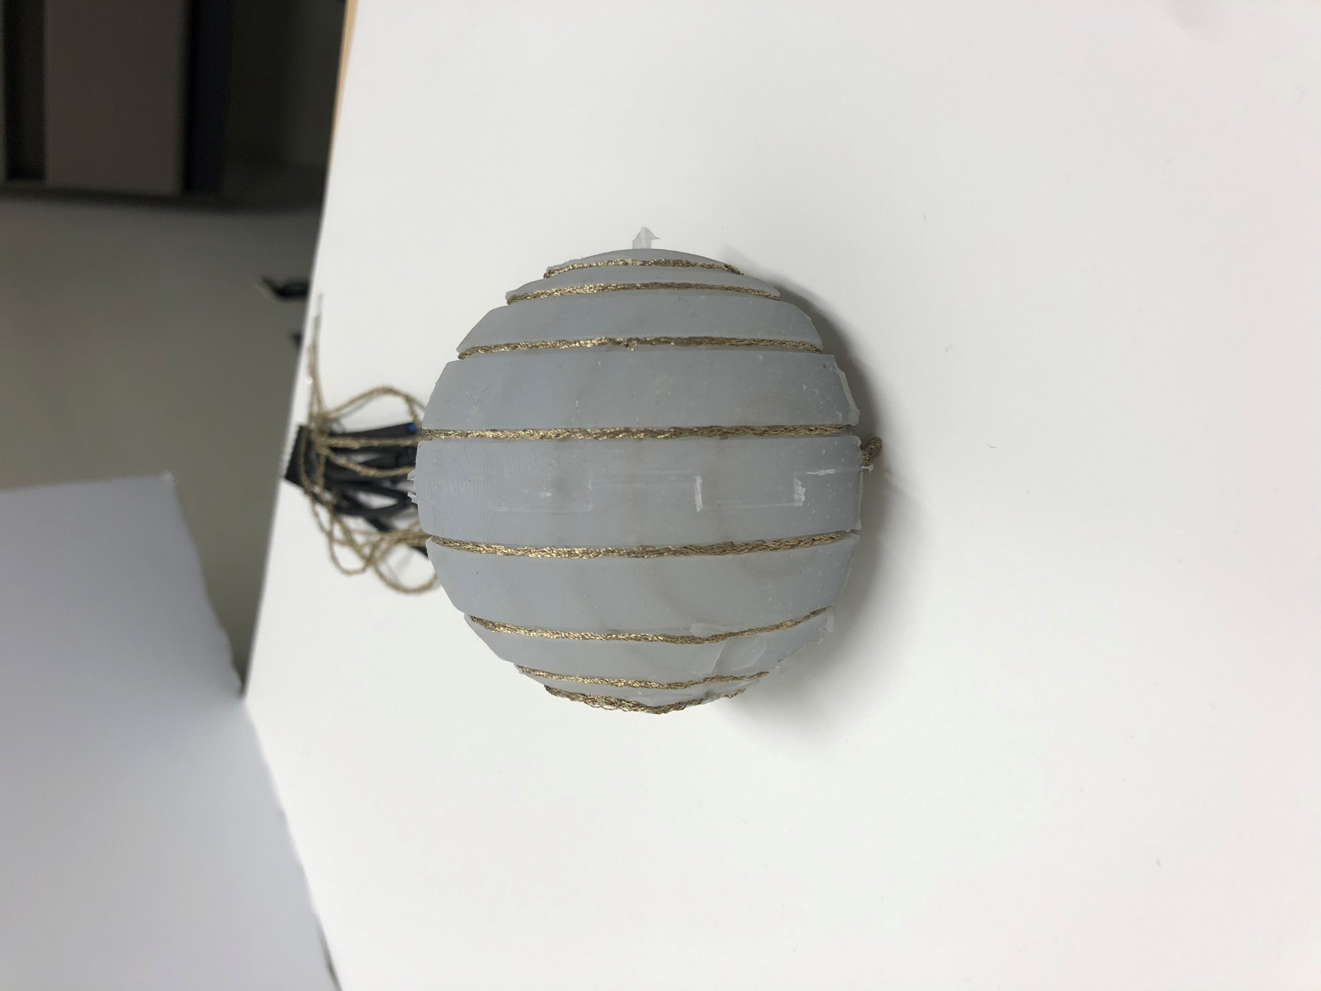
FABRICATION
3D Printed Molds
Casting Silicone Rubber
Nylon Thread Electrodes

Slide 6
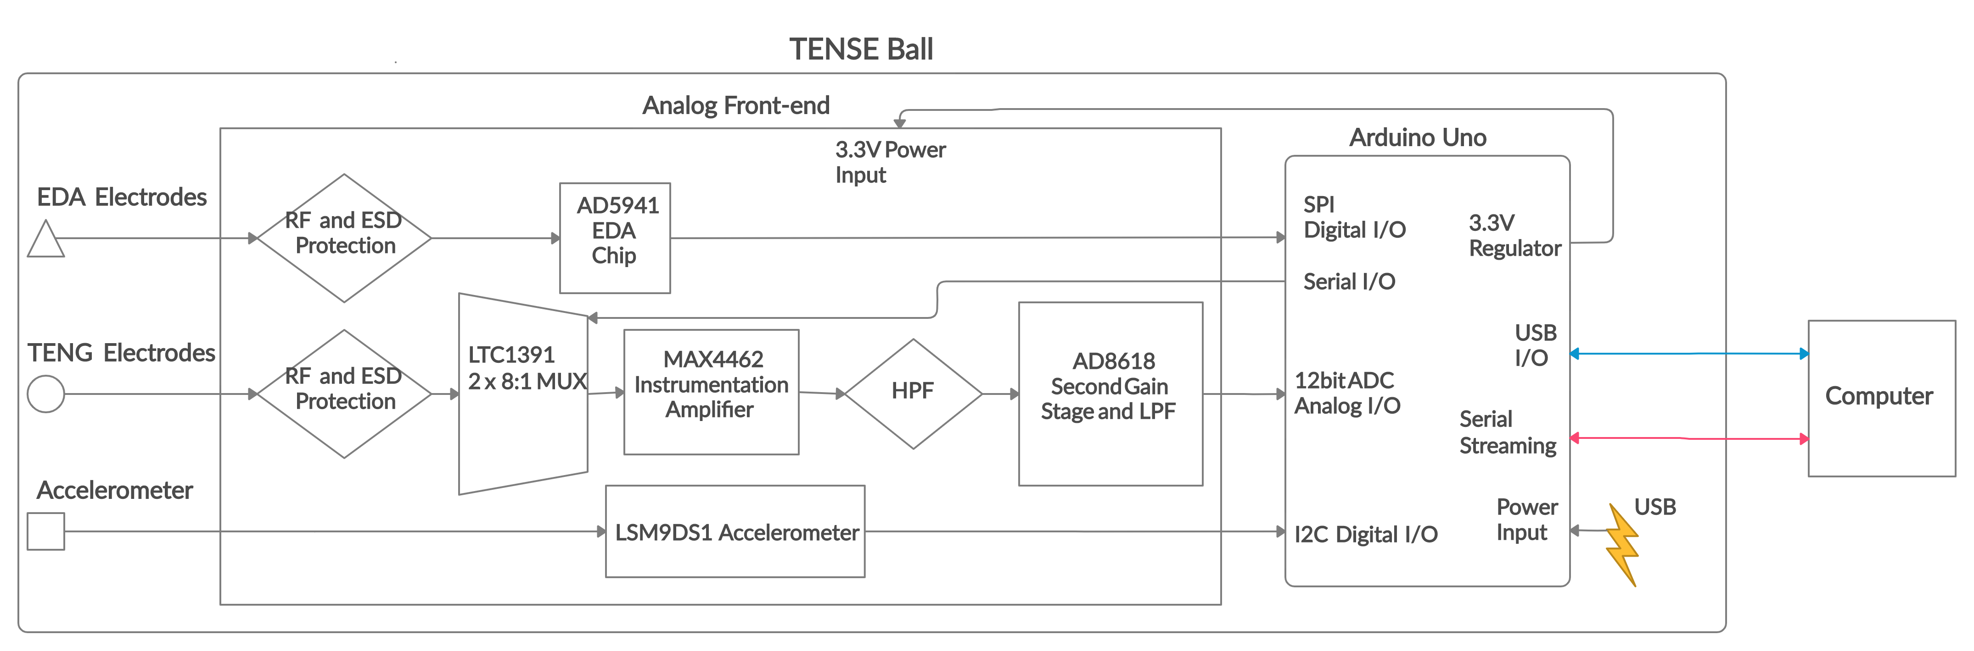
EMBEDDED SYSTEM ARCHITECTURE

Slide 7
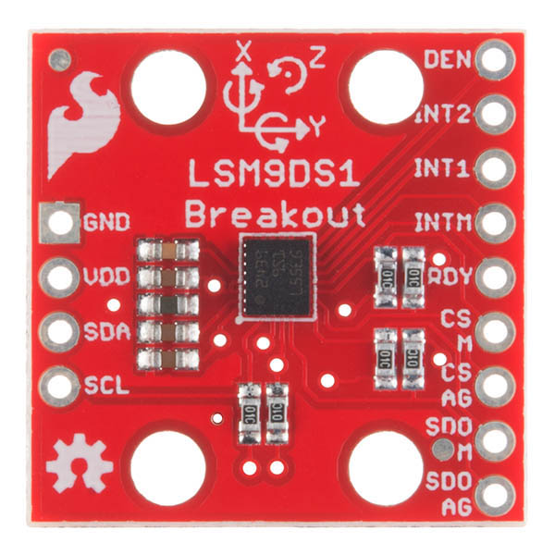
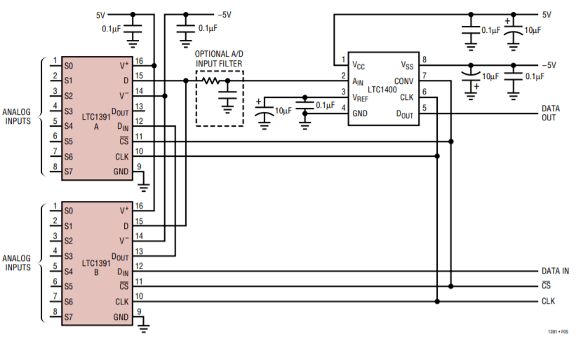
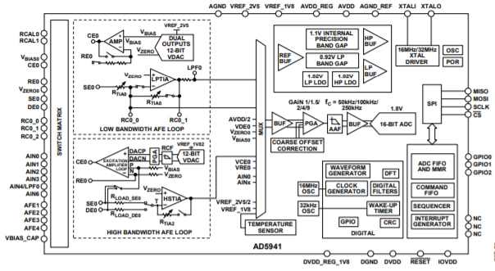
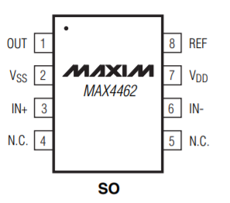
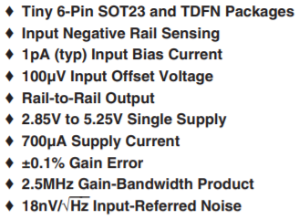
SYSTEM COMPONENTS
LSM90S1
LTC 1391
AD 5940

Slide 8
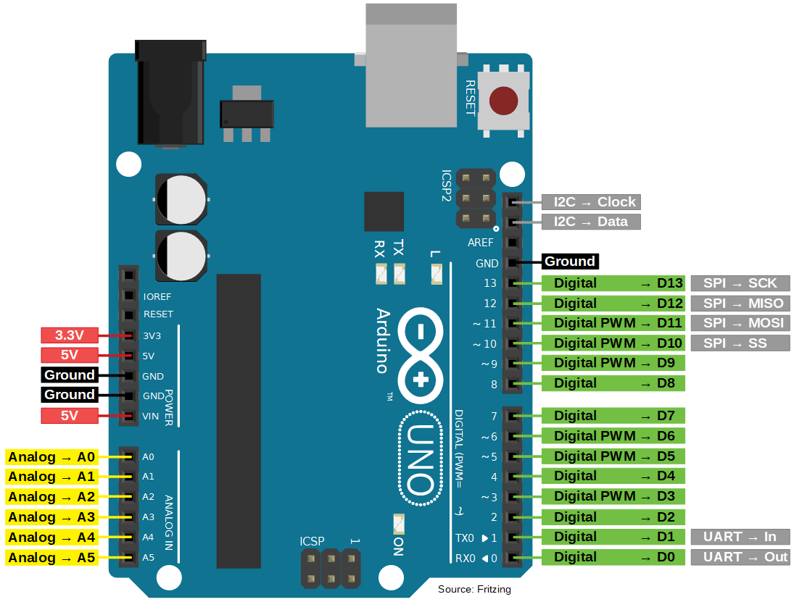
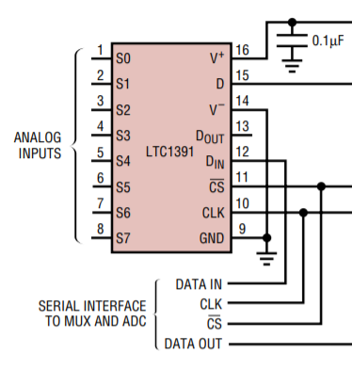
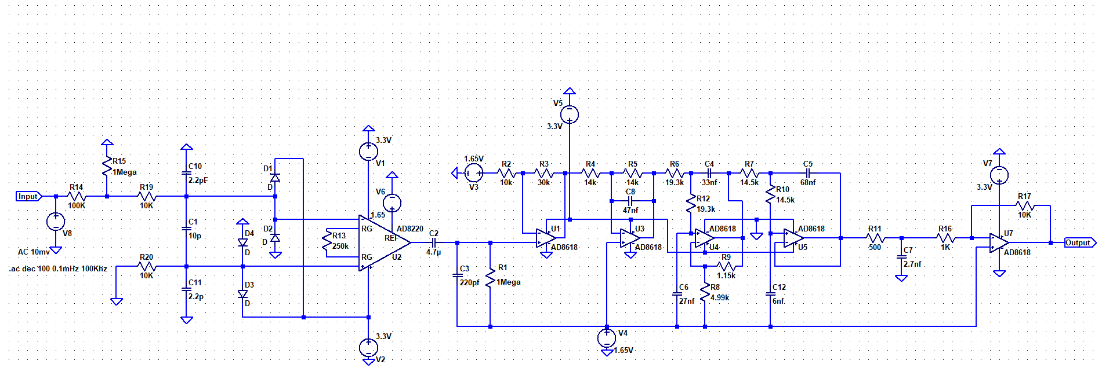
TENG CIRCUIT DESIGN & SIMULATION
Non-inv Amp
Gain: 4
Instrumentation Amplifier
RF Protection
ESD Protection
Unity Gain Inverting Amplifier
5th Order LPF – 200Hz
HPF – 30mHz

Slide 9
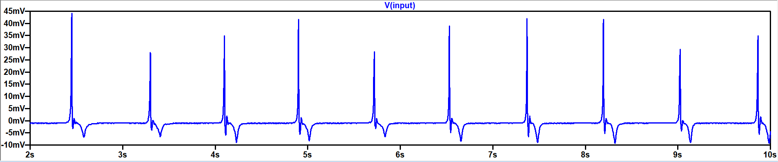
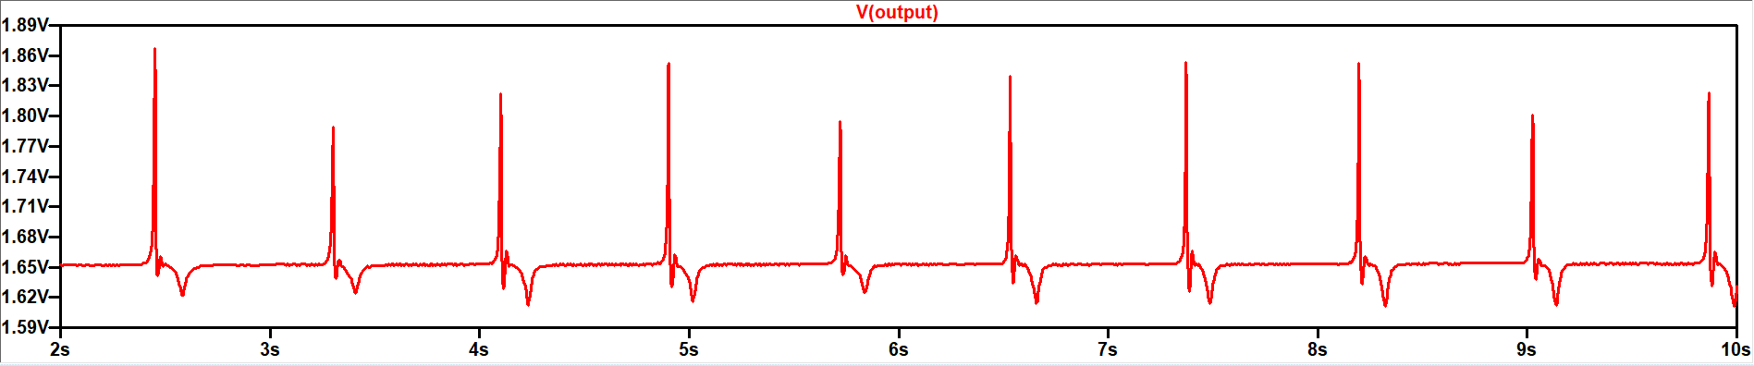
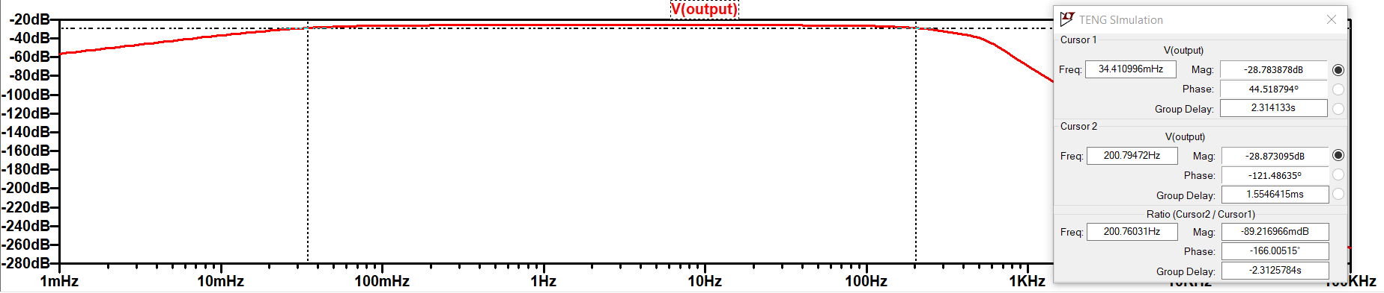
TENG CIRCUIT DESIGN & SIMULATION
Simulated signal input
Simulated signal output
Circuit frequency response

Slide 10
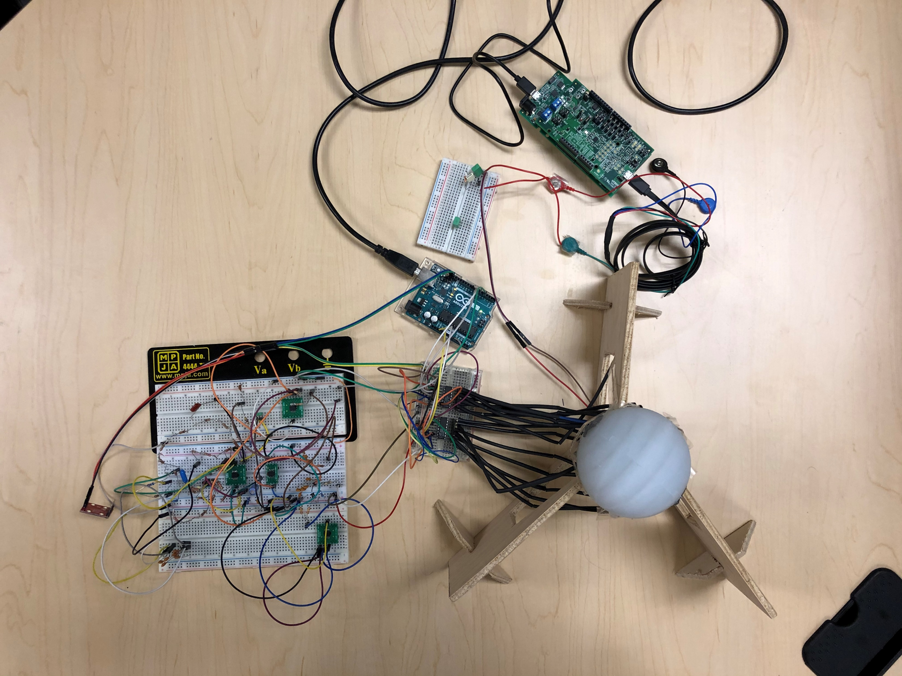
ASSEMBLED TENSE PROTOTYPE SYSTEM
EVAL- AD5940BIOZ for EDA
EDA Current Limiting & Isolation
Arduino Uno MCU
Arduino Uno MCU
TENG Sensor Network
TENG Conditioning Circuit

Slide 11
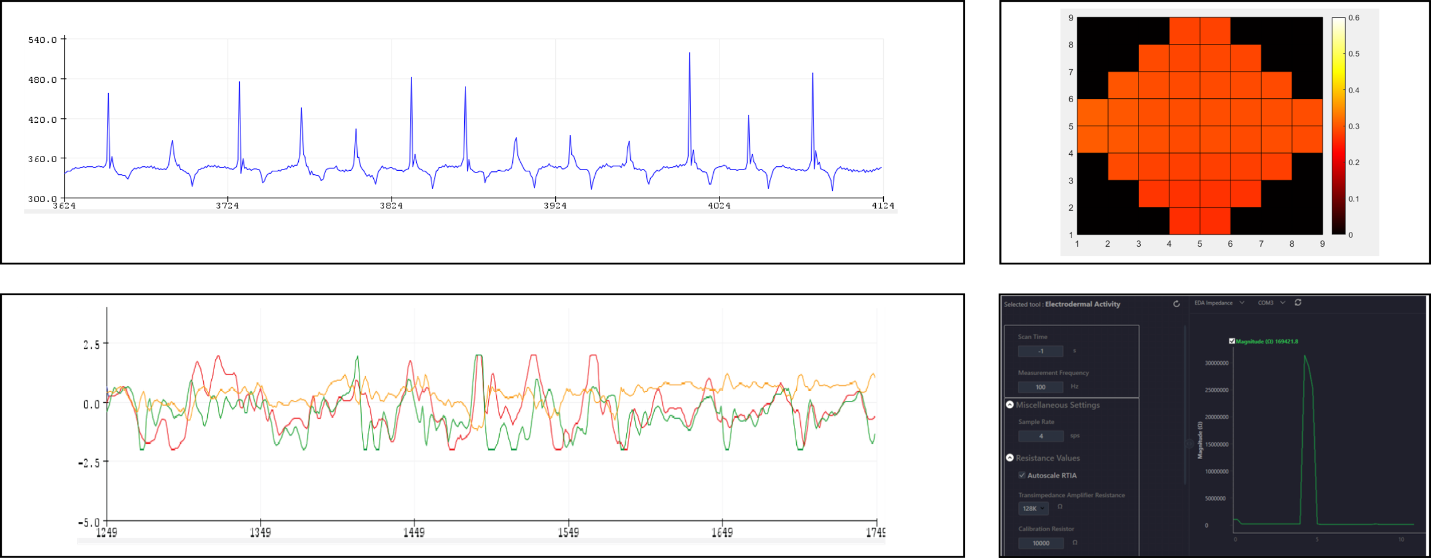
ASSEMBLED TENSE PROTOTYPE SYSTEM
1
2
3
4
1) Single channel TENG response, 2) Heatmap of the entire electrode network, 3) 3-axis accelerometer signals, 4) EDA readout interface

